Slide 1
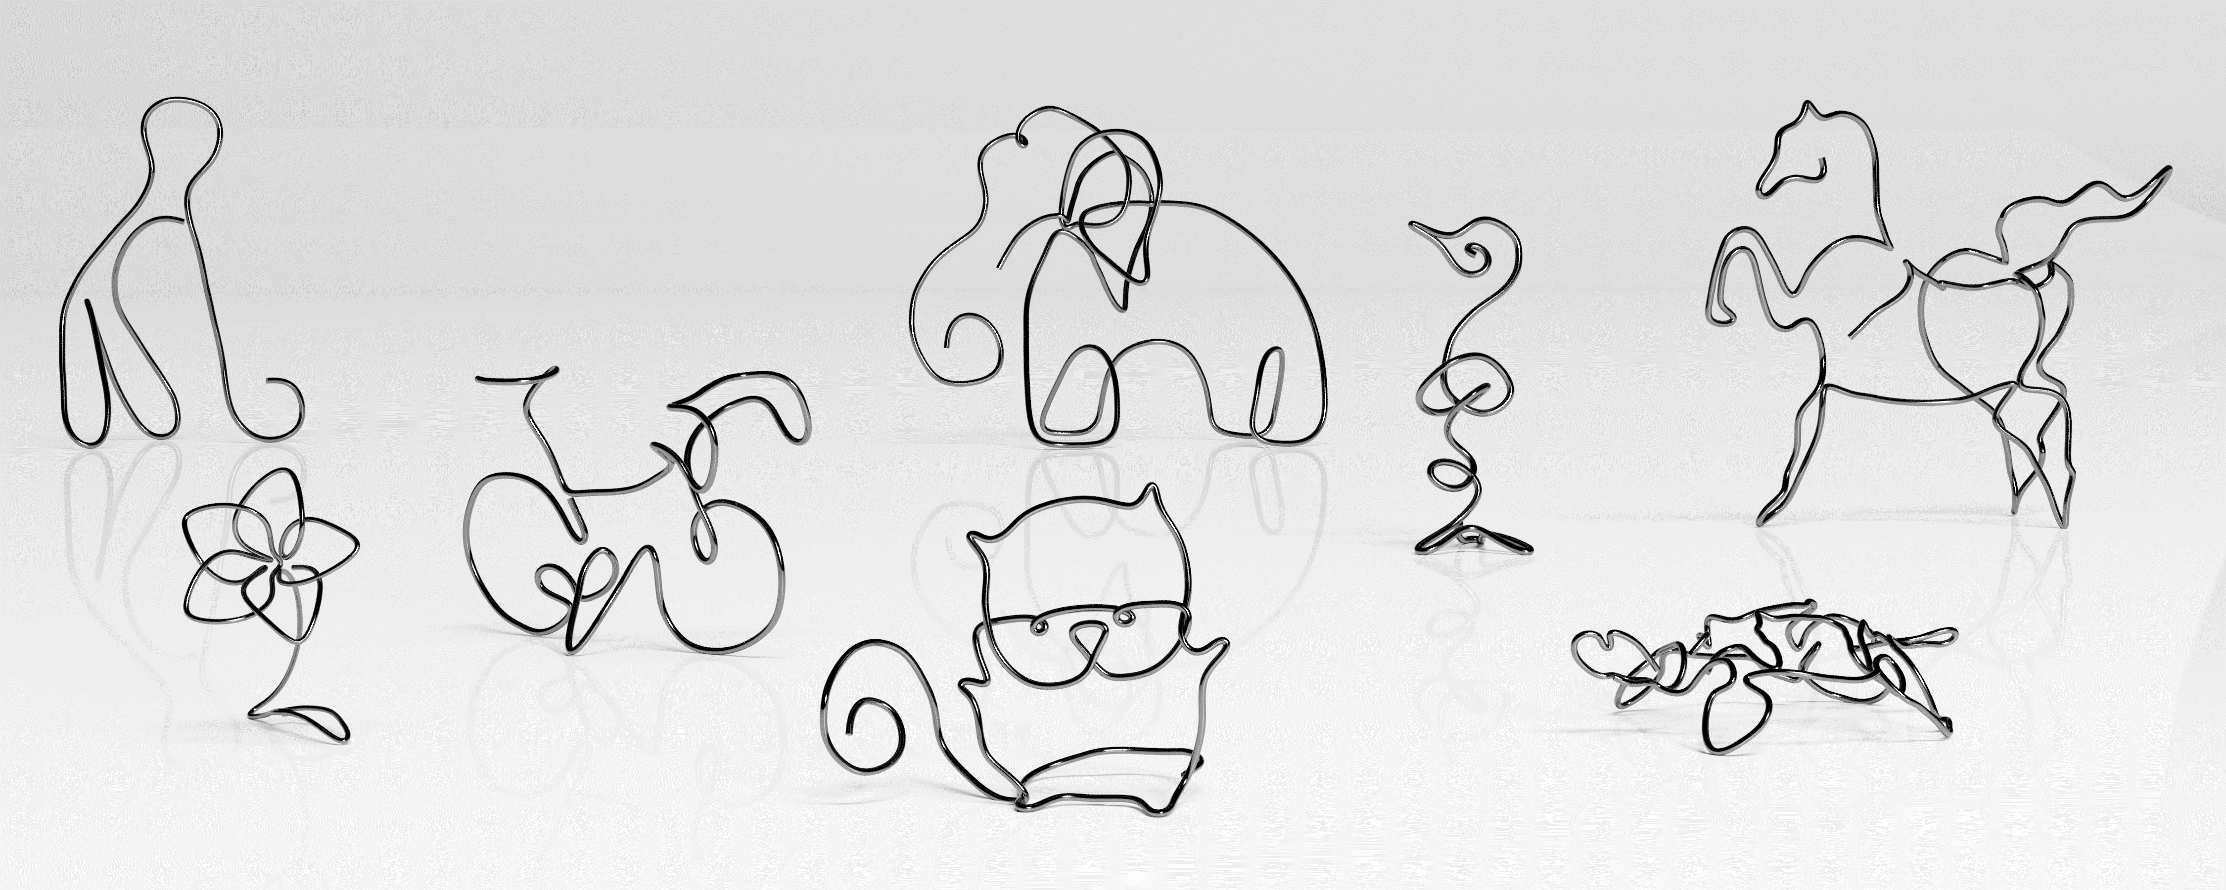
Image-based Reconstruction of Wire Art
Lingjie Liu^{1,2}, Duygu Ceylan³, Cheng Lin¹, Wenping Wang¹, Niloy J. Mitra²
¹The University of Hong Kong ²University College London ³Adobe Research

Slide 2
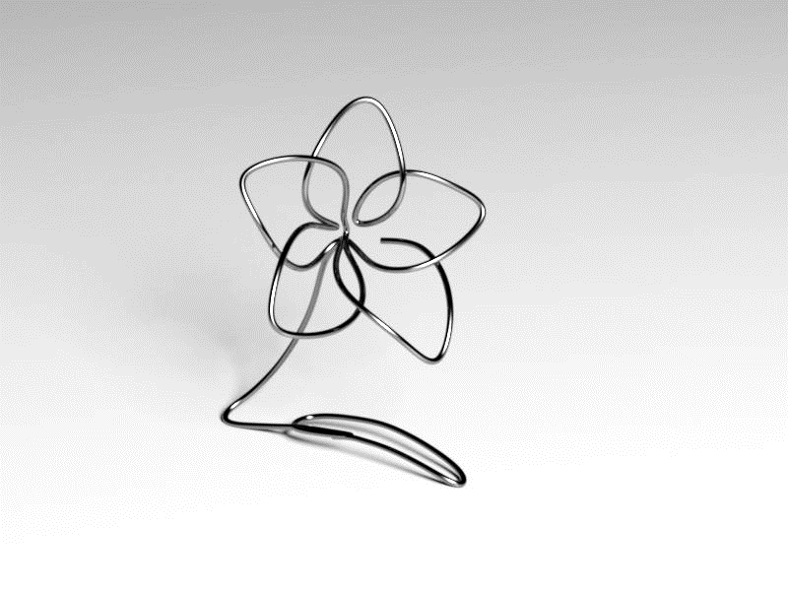
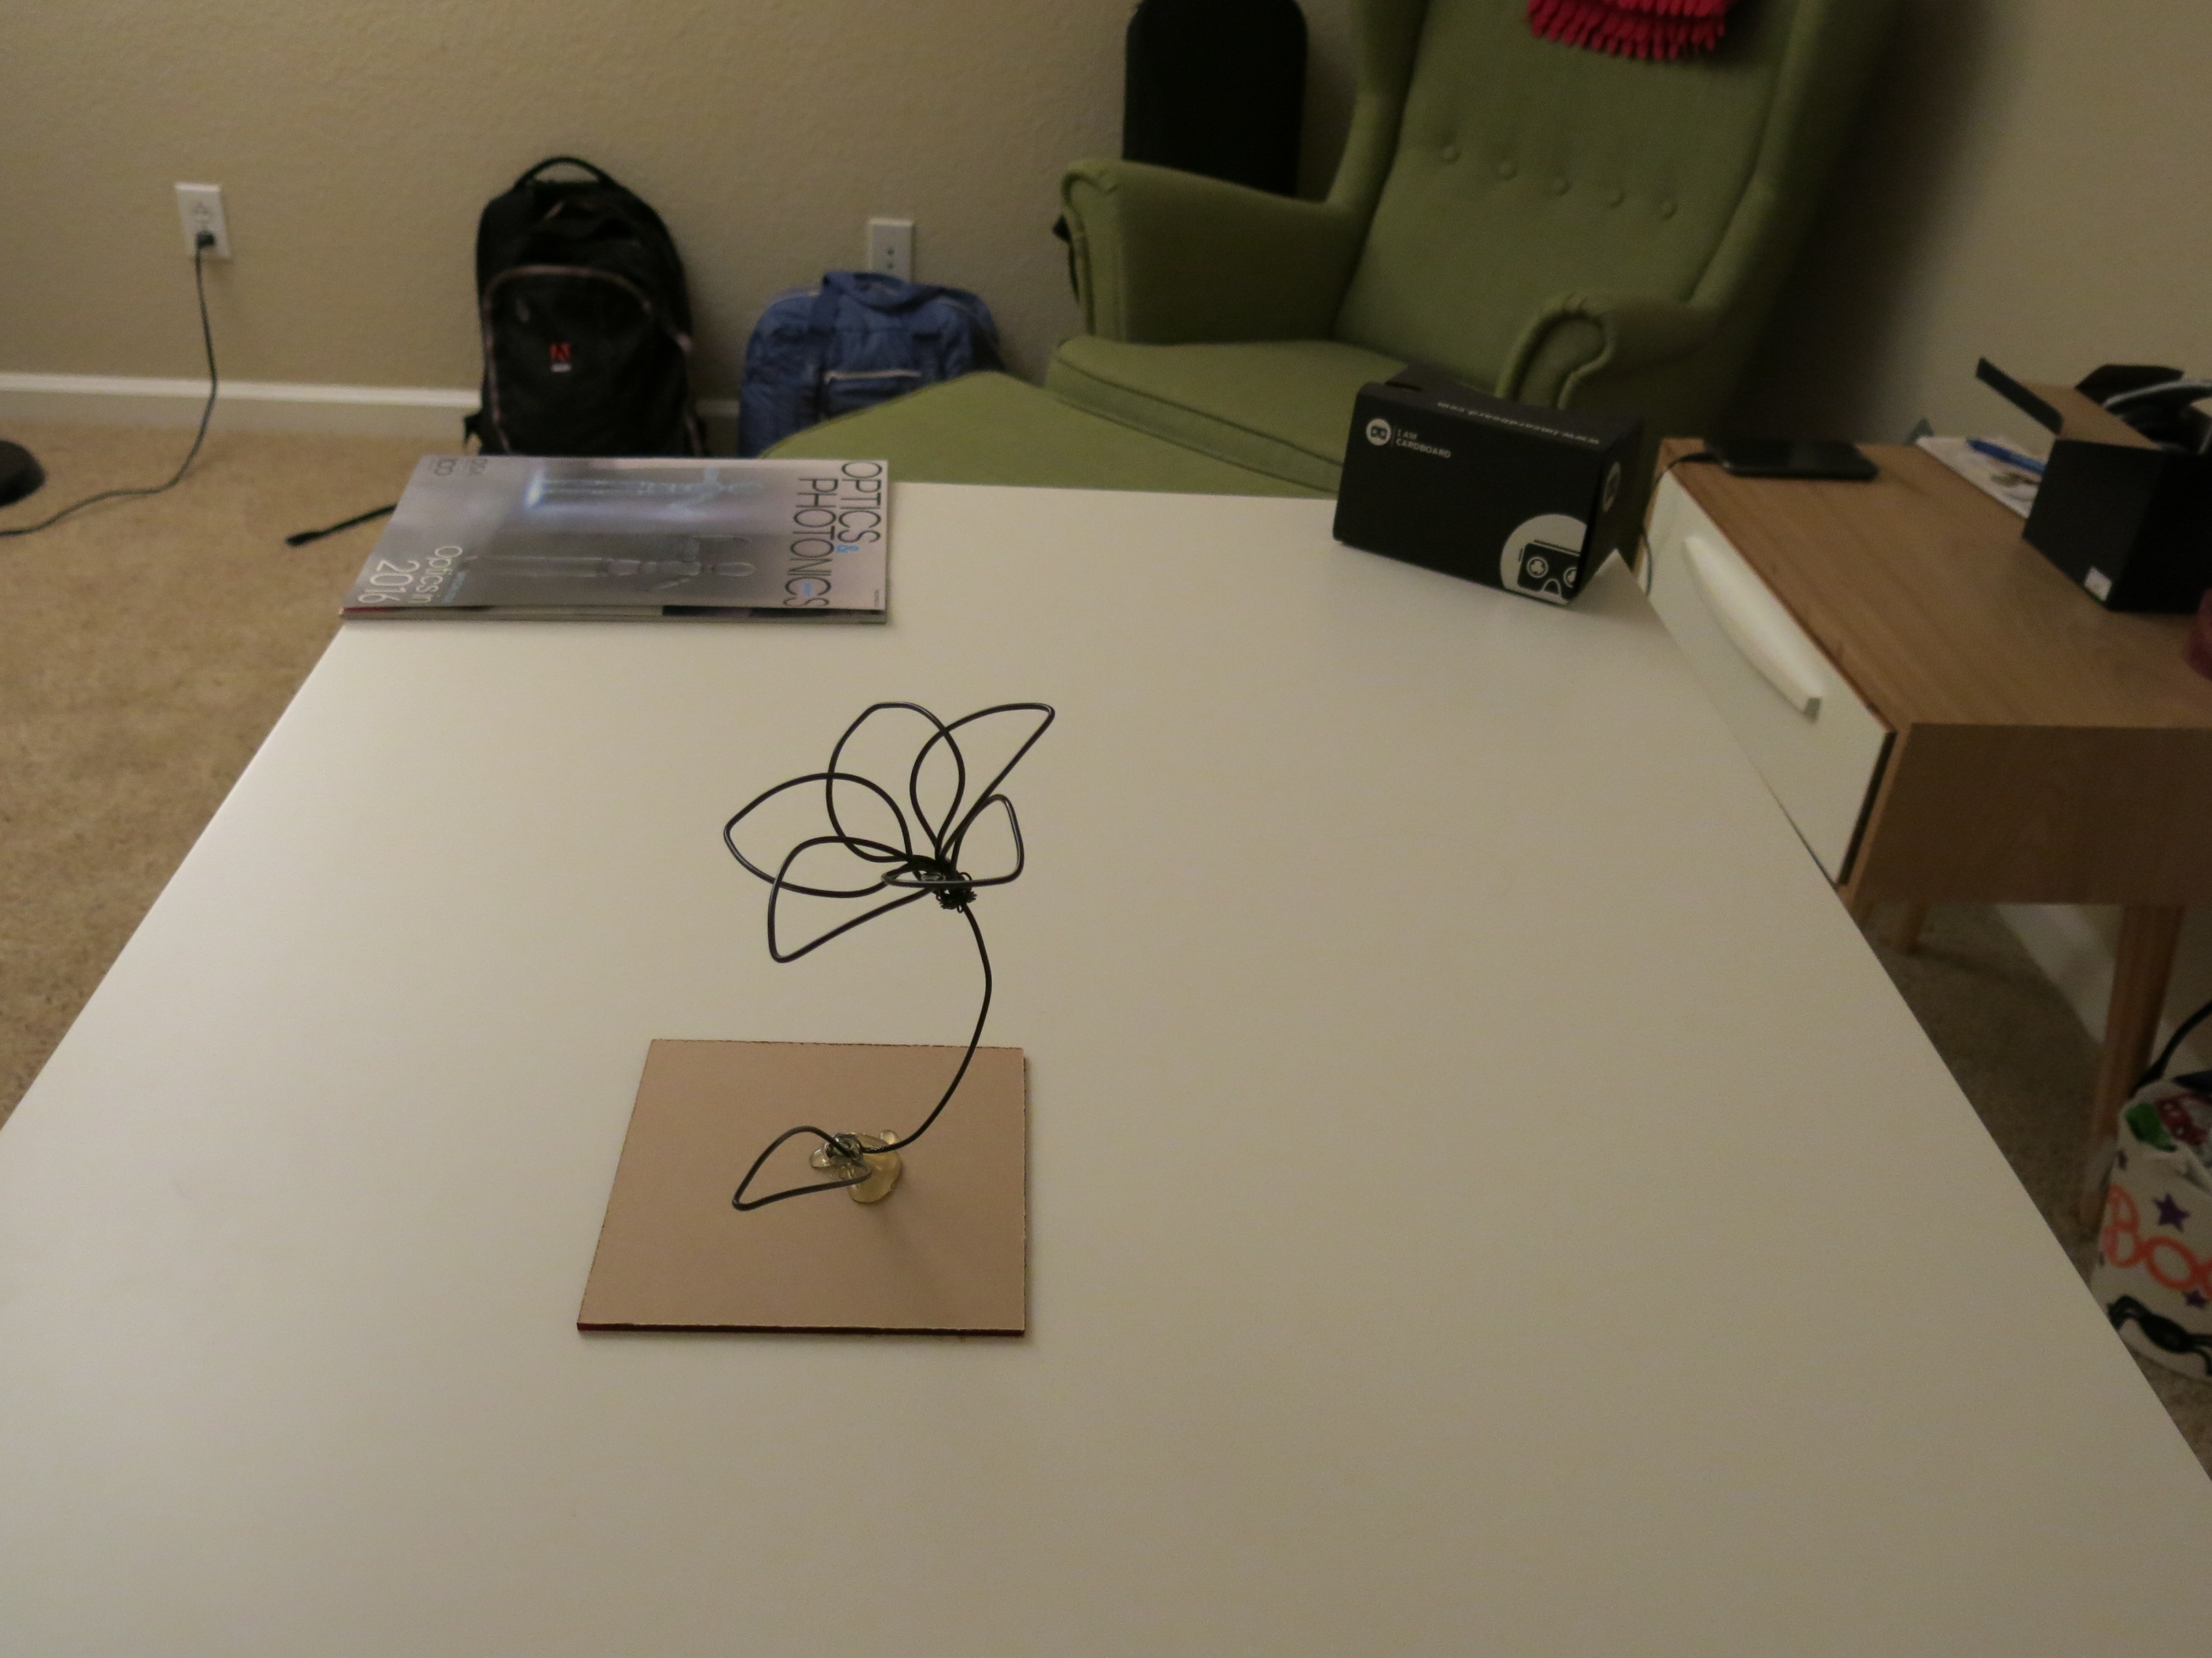
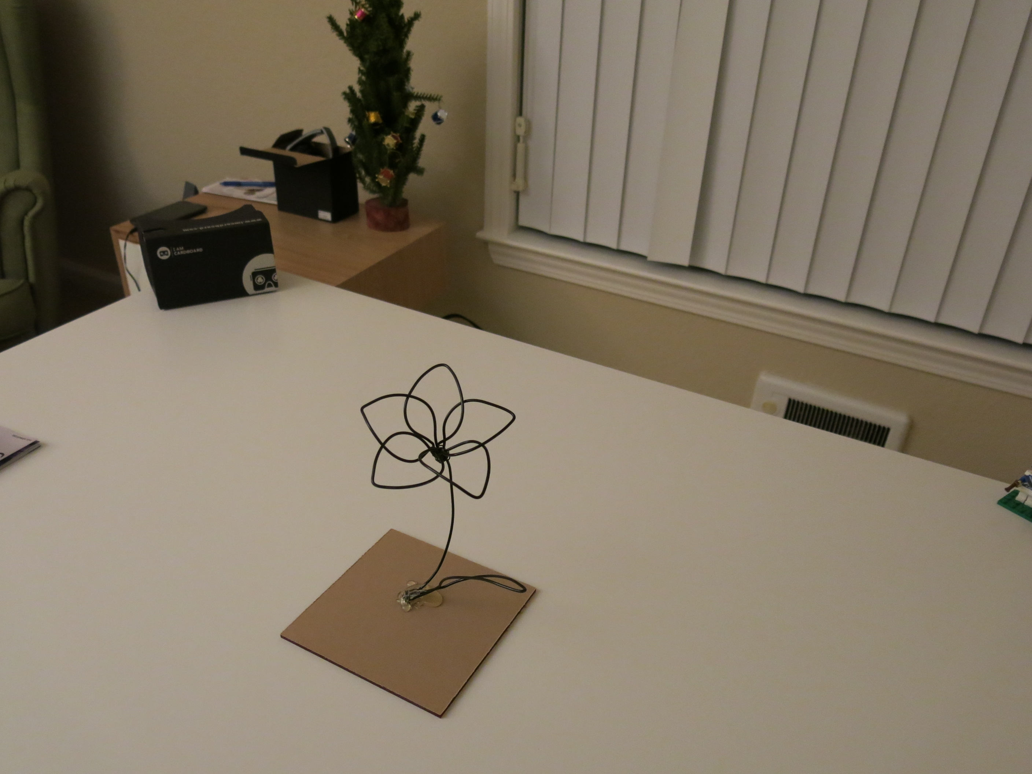
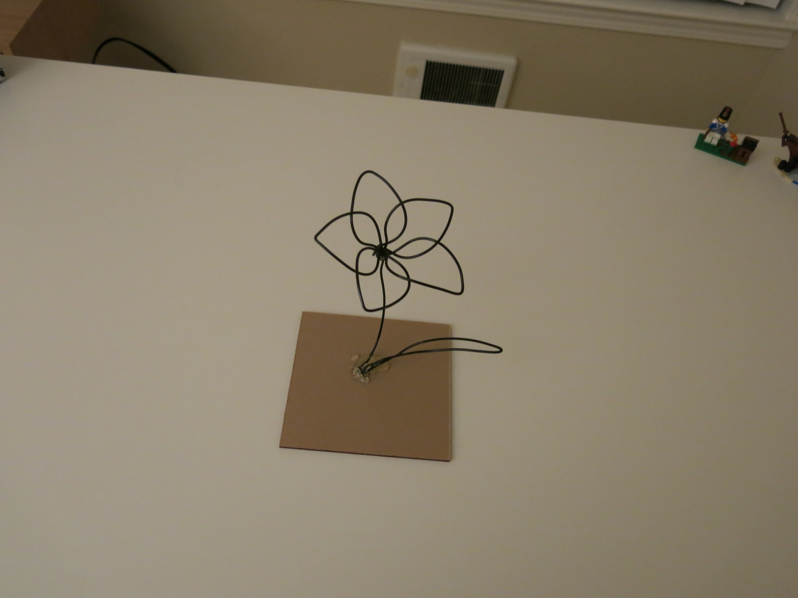
Input & Output
3 input views
Result

Slide 3
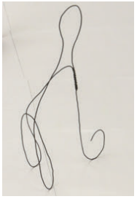
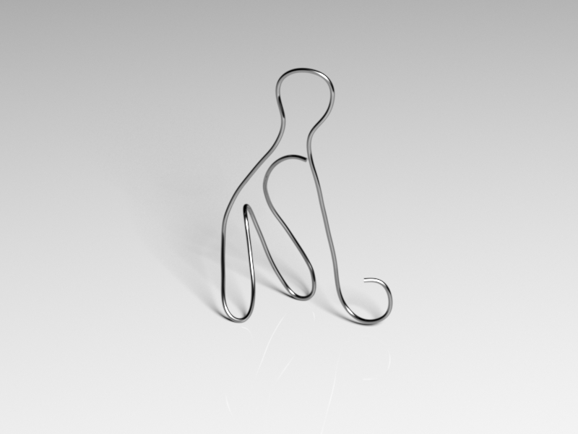
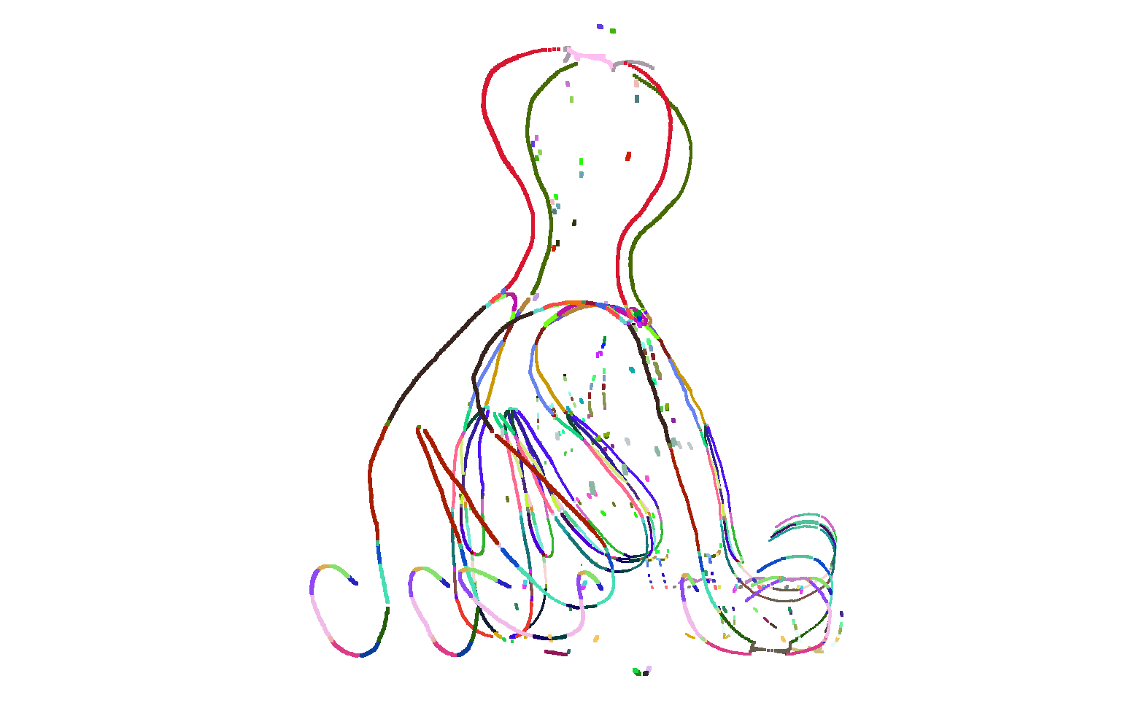
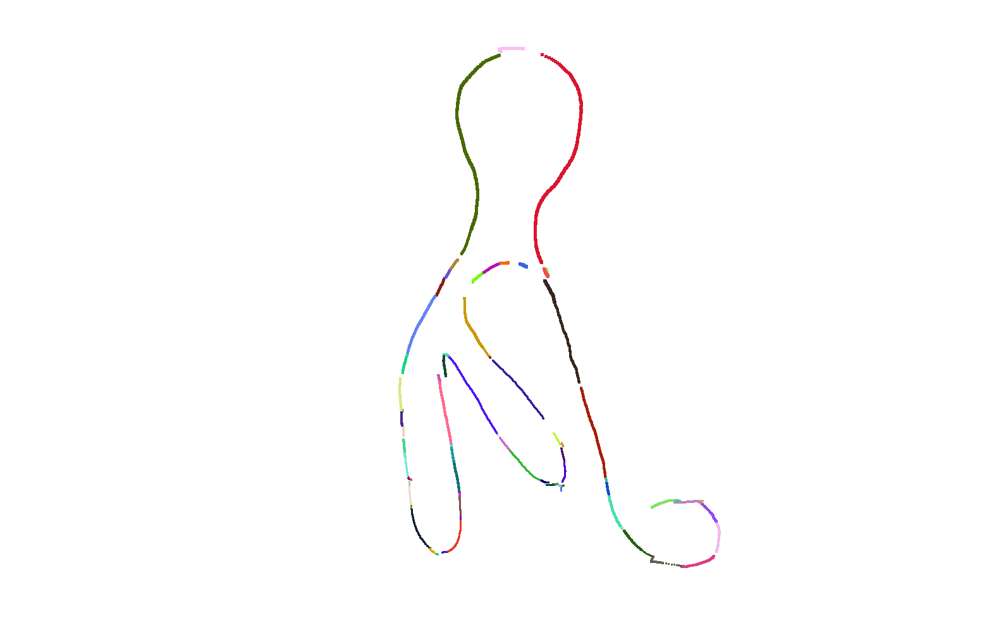
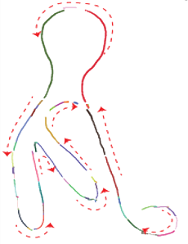
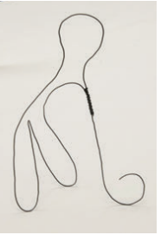
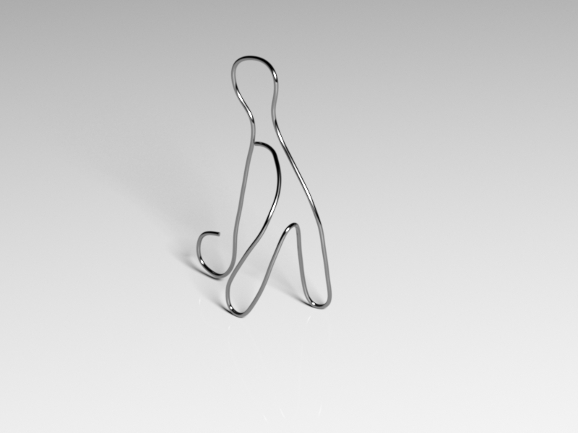
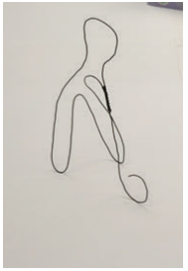
Process
3D Curve
Generation
3D Wire
Decomposition
final reconstruction
Input images
3D candidate curve generation
3D curve selection
recovered curve ordering

Slide 4
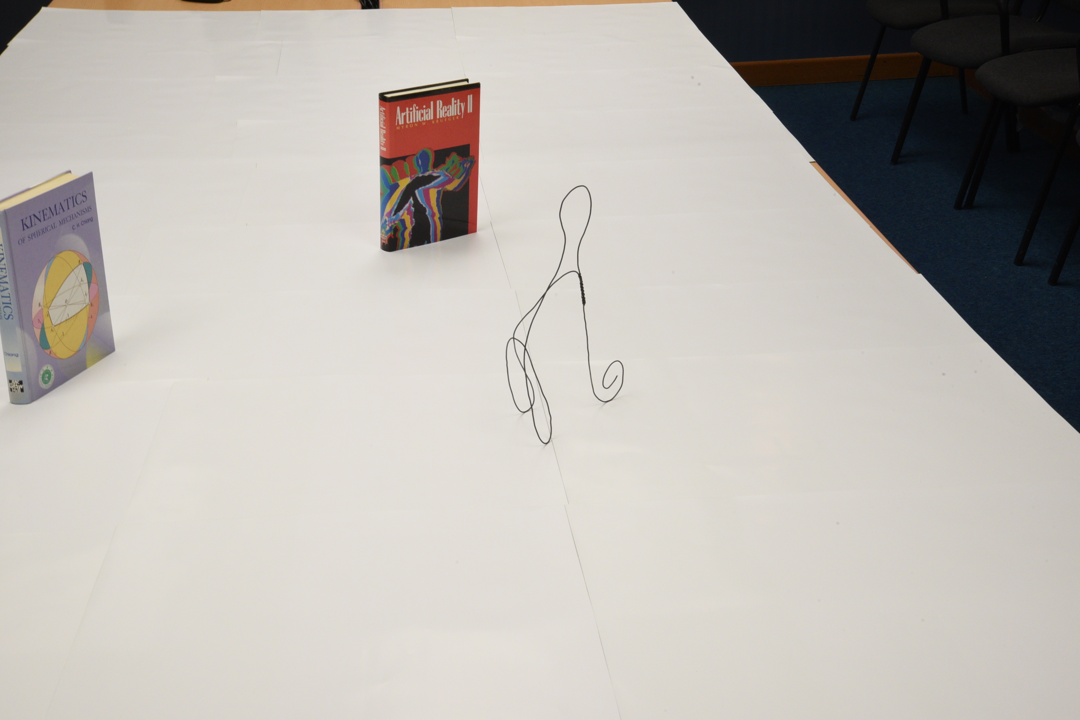
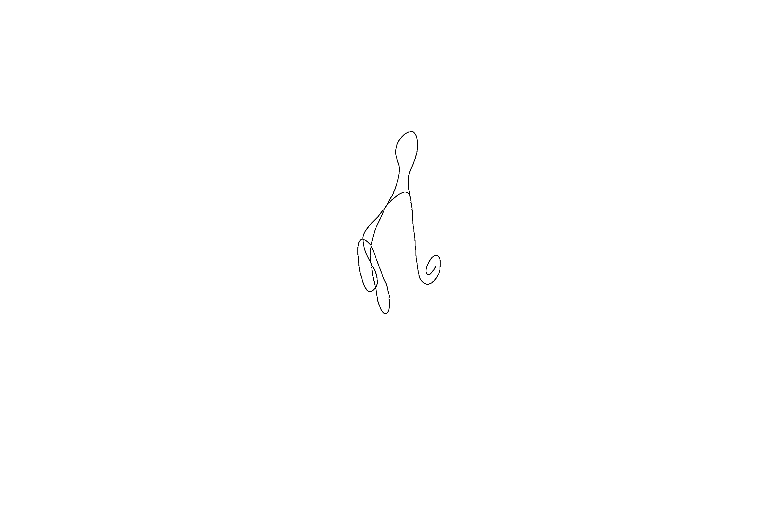

Preprocessing:
Detecting 2D Curve Segments
input image
Pixel-wide 2D curves
2D curve segments
Preprocessing using Peter’s Functions for Computer Vision (Kovesi 2017)

Slide 5
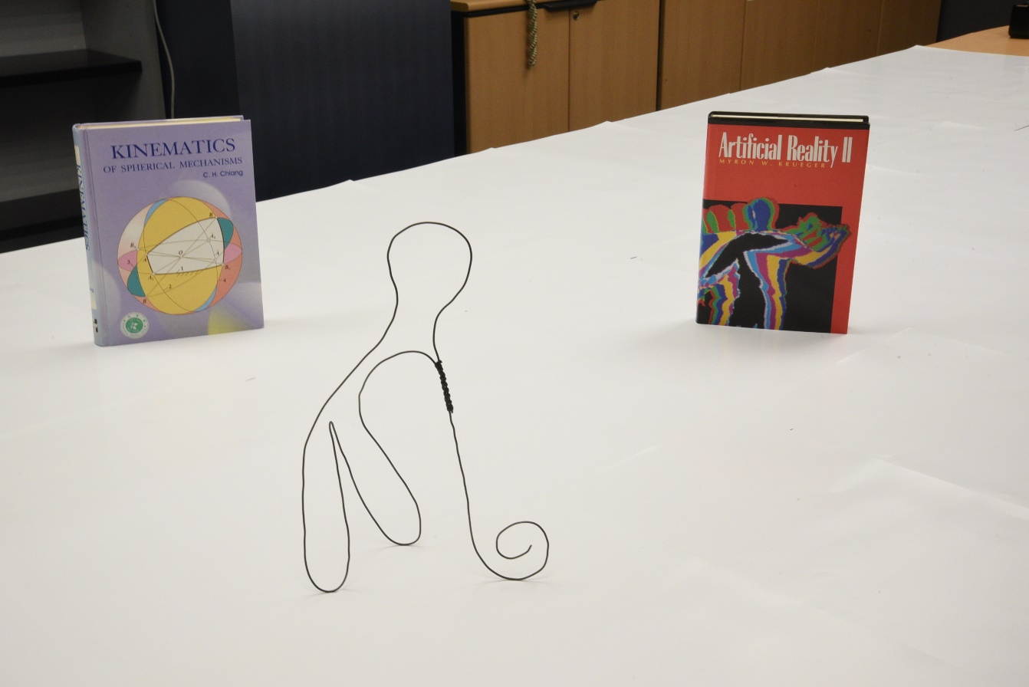
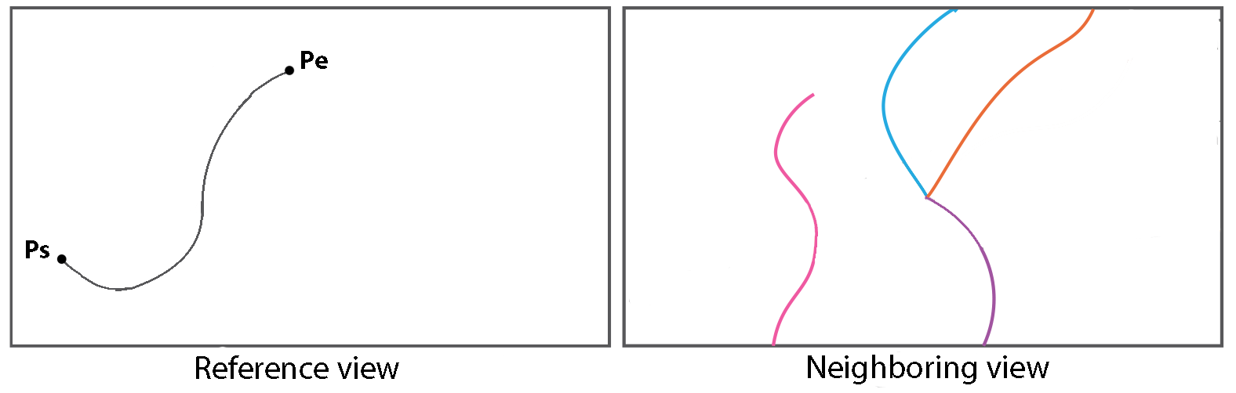
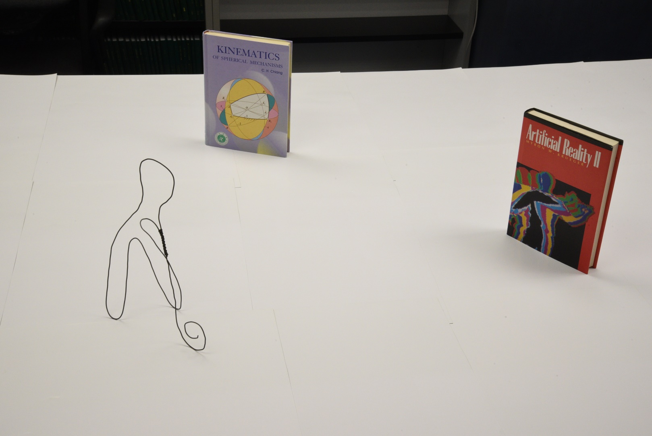
3D Curve Generation
Epipolar Constraints
reference view
neighboring view
potential matches

Slide 6
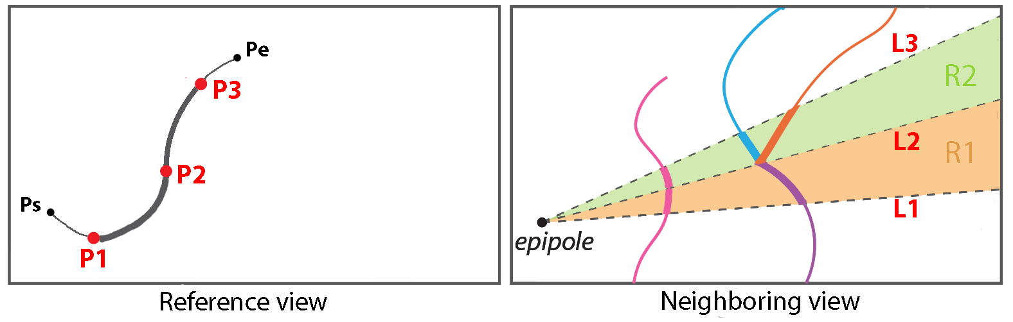
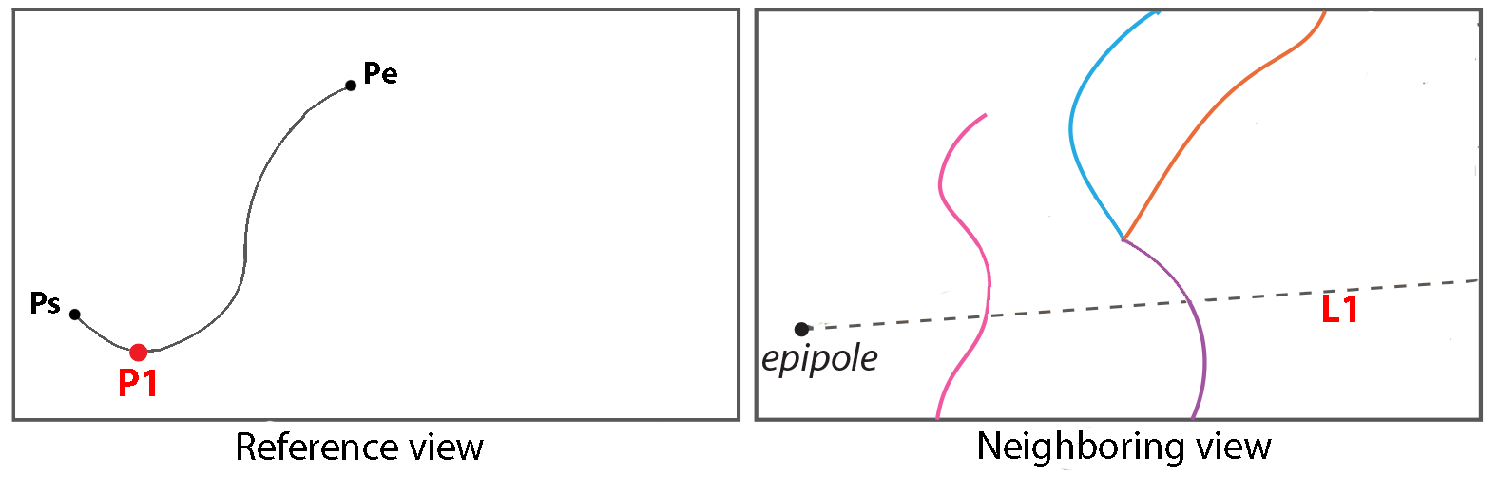
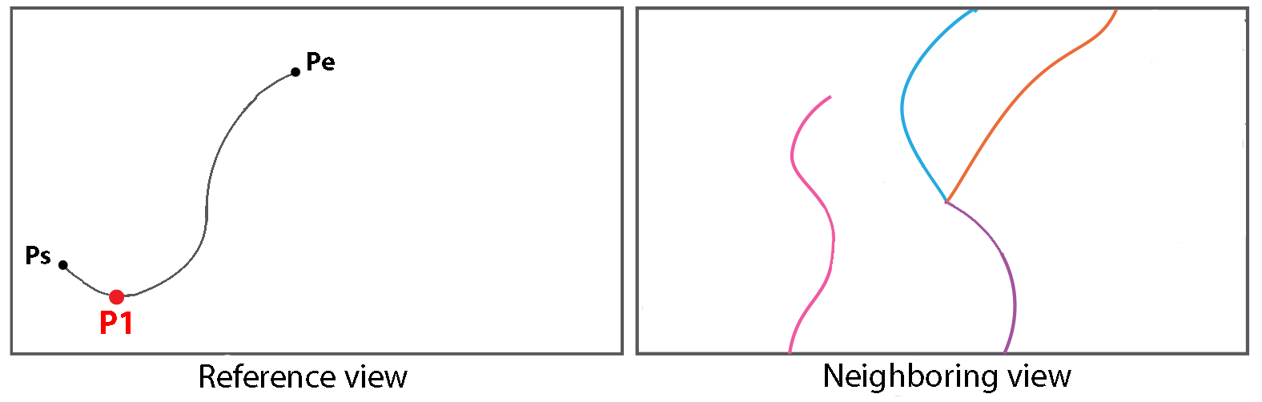
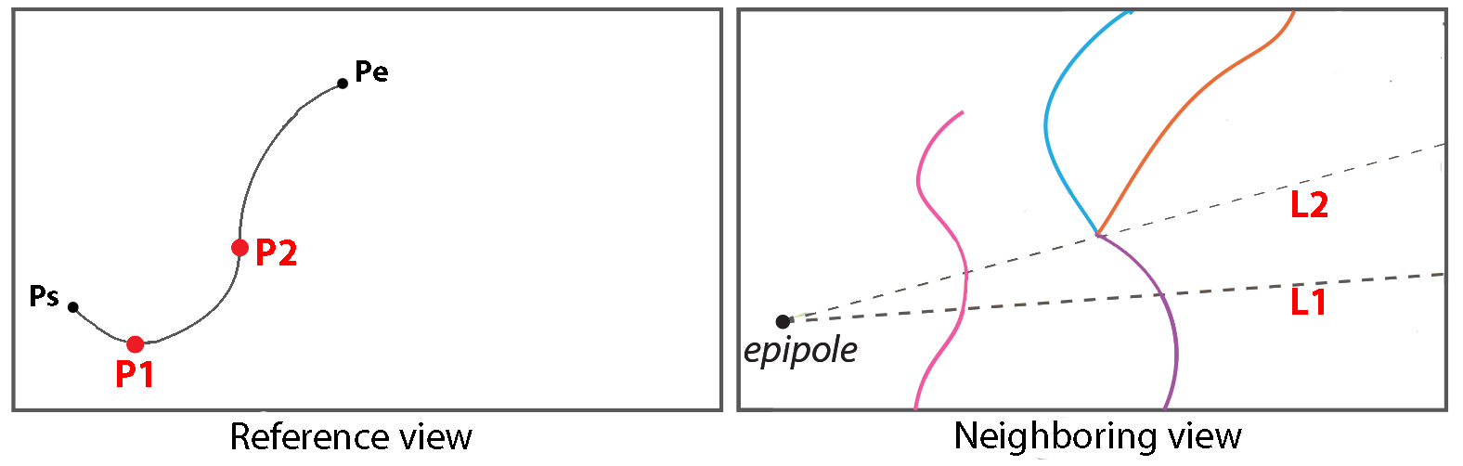
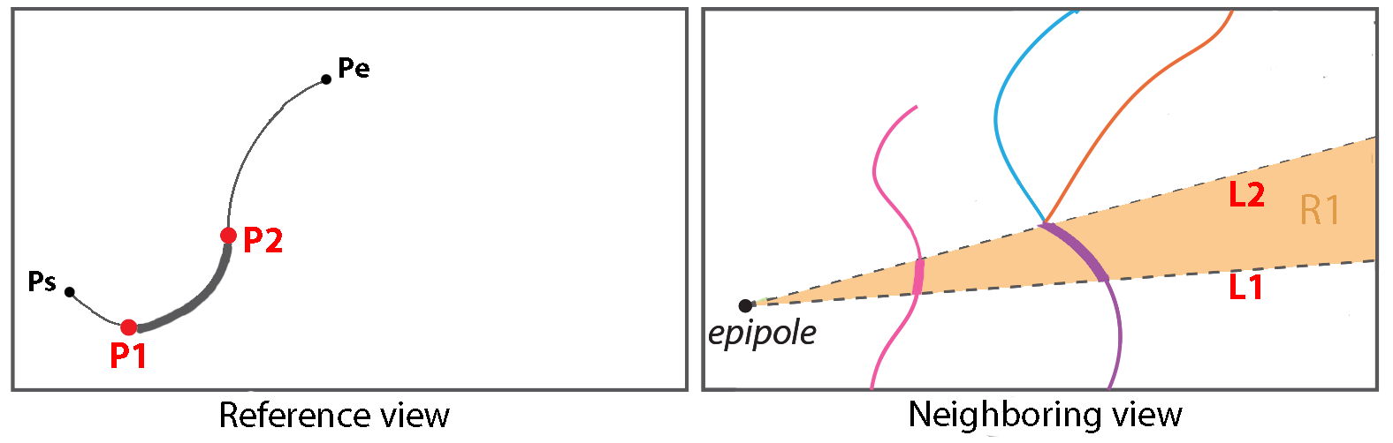
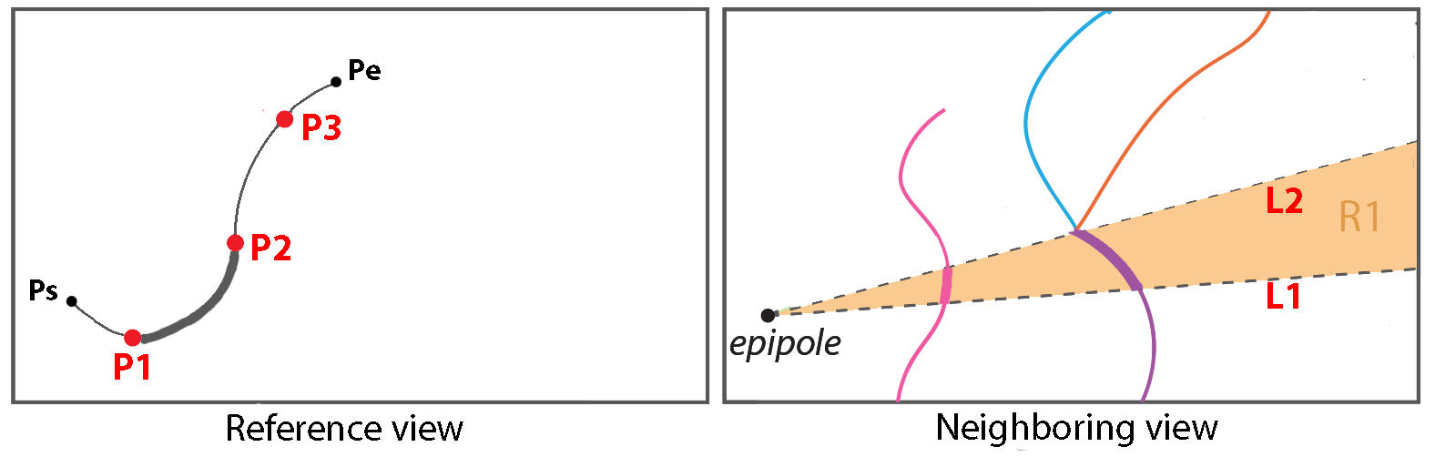
3D Curve Generation

Slide 7
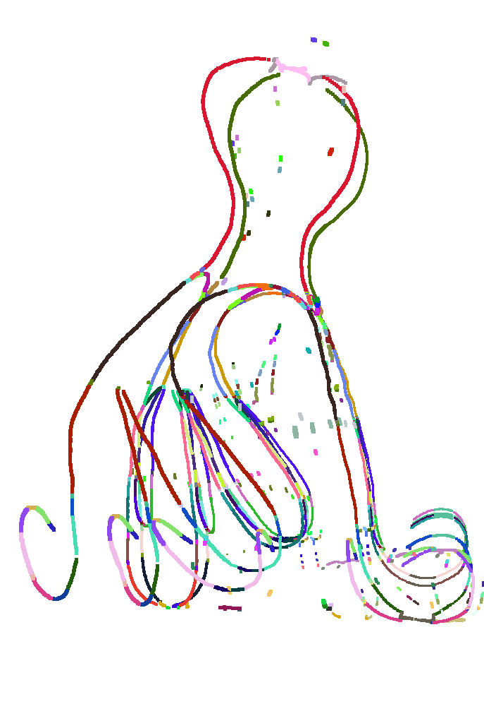
3D Curve Generation
2D curve segments in the reference view
Candidate 3D curve segments

Slide 8
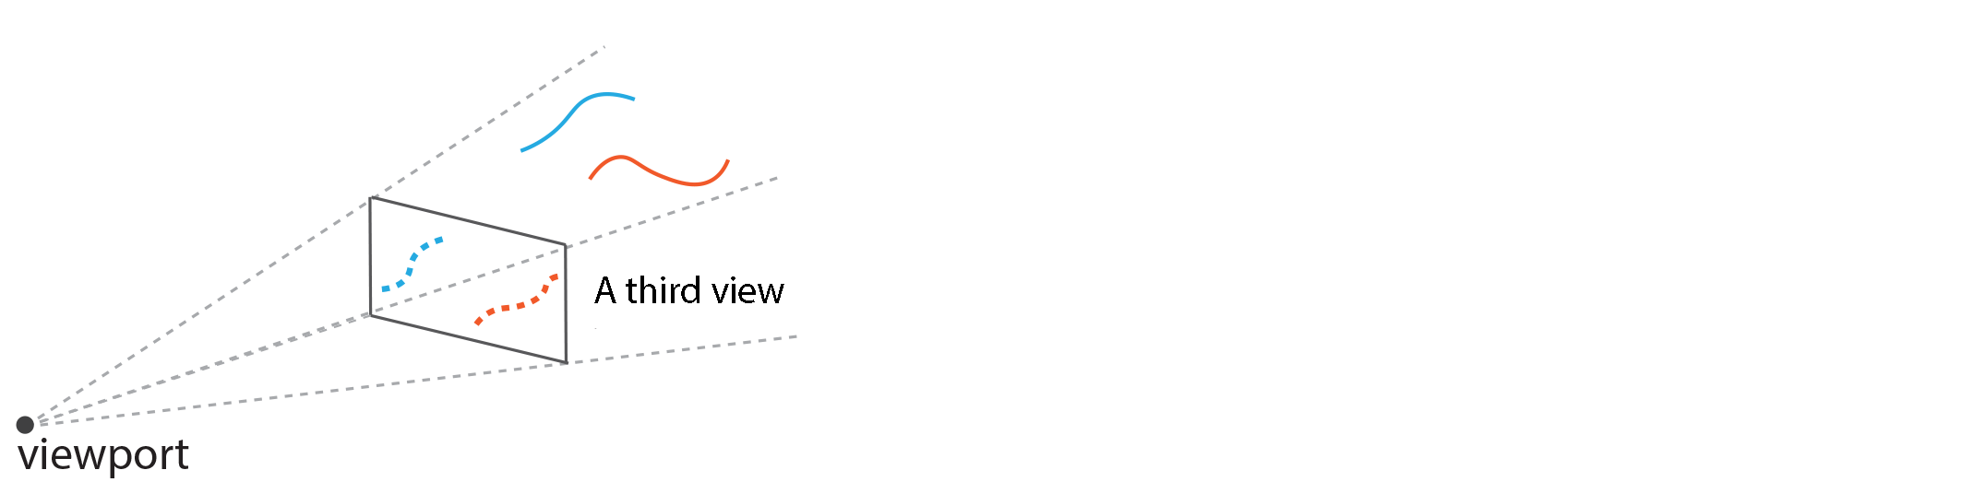

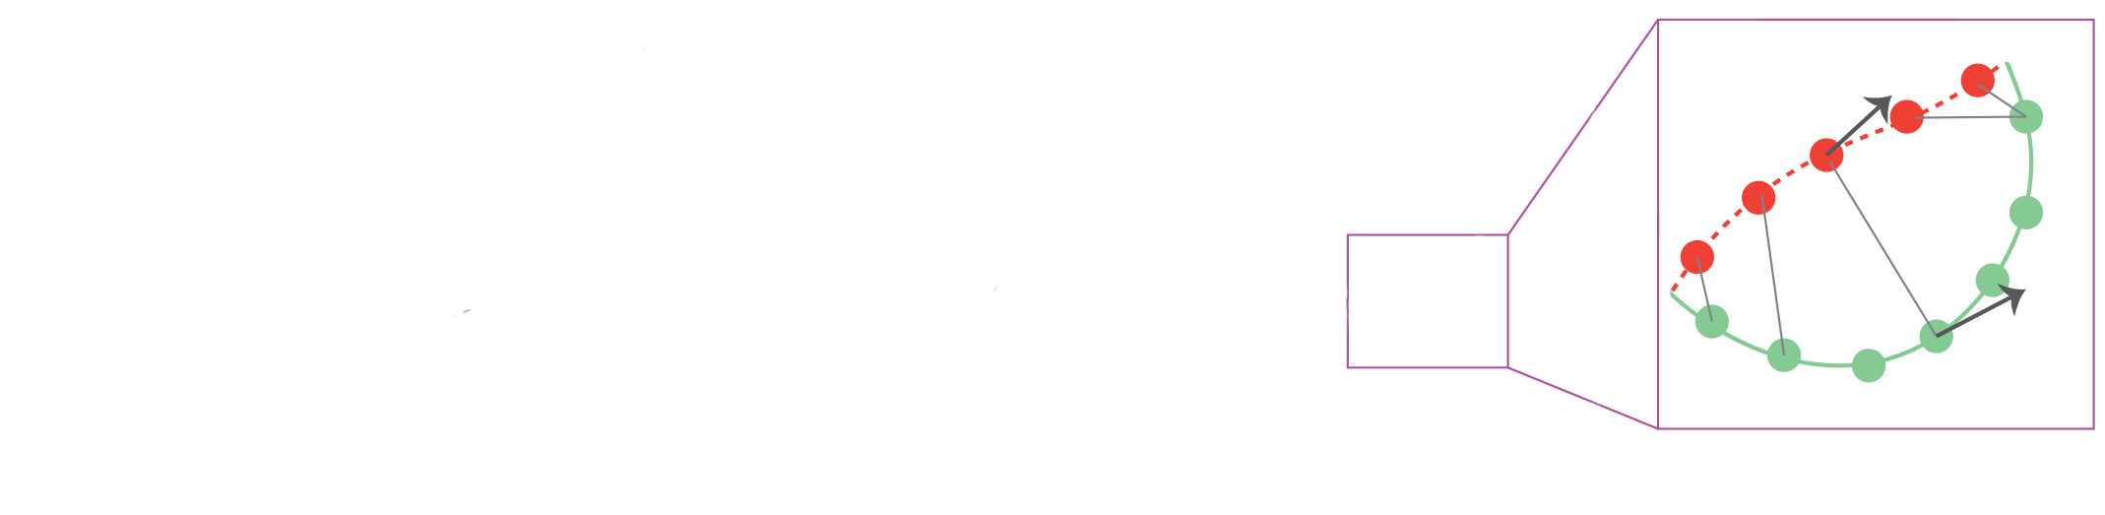
3D Curve Selection
Cue 1: Confidence cost: Consistency wrt a third view
C2
C1
c2’
c1’
Confidence cost = Distance measures + η * Tangential deviation

Slide 9
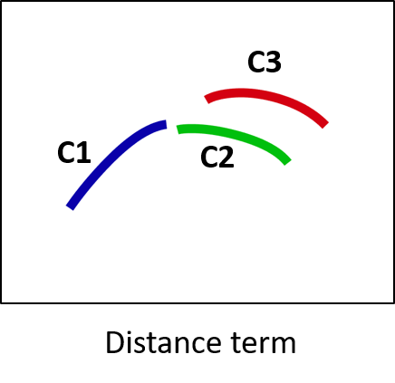
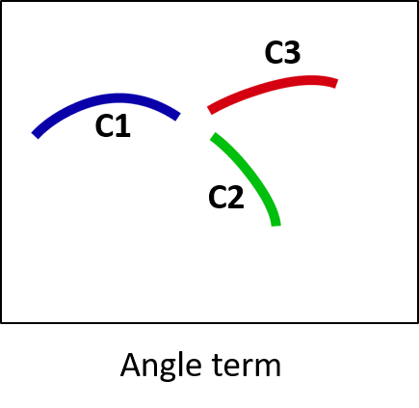
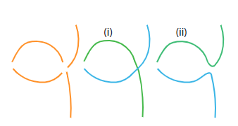
3D Curve Selection
Cue 2: Pairwise cost: Smoothness of pairs of nearby 3D curve segments
Pairwise cost = Distance term + μ * Angle term

Slide 10
3D Curve Selection
2D curve segments in the reference view
Candidate 3D curve segments
Selected 3D curve segments

Slide 11
3D Wire Decomposition
Goal: connect the selected curve segments into multiple wires.
Multiple Traveling Salesman problem (mTSP)

Slide 12
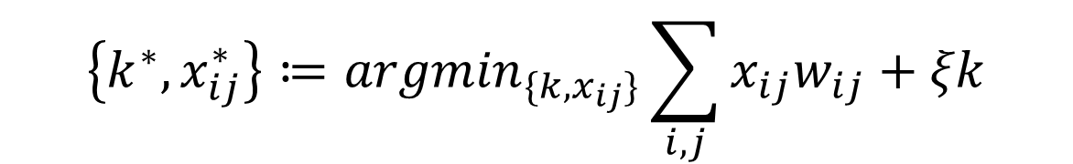
3D Wire Decomposition
w_{ij}: cost of the edge
x_{ij}: denotes if this edge is selected or not
j
i
$$\left\{k^{∗}, x_{ij}^{∗}\right\}≔{argmin}_{\{k,x_{ij}\}}\sum_{i,j}{x_{ij}w_{ij}+ξk}$$
k: number of wires

Slide 13
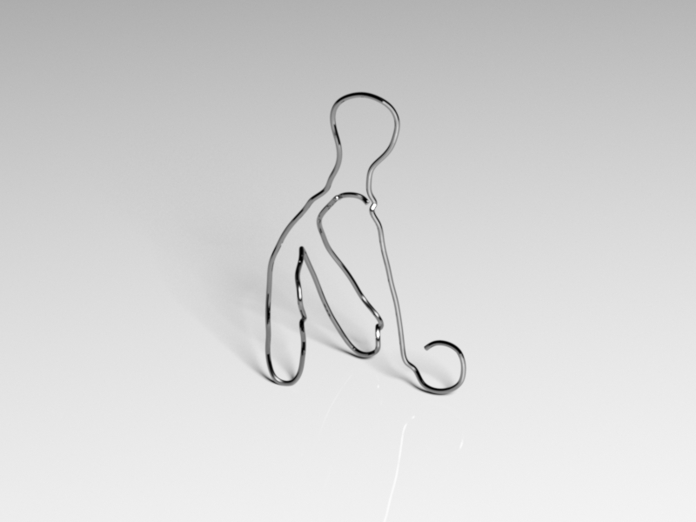
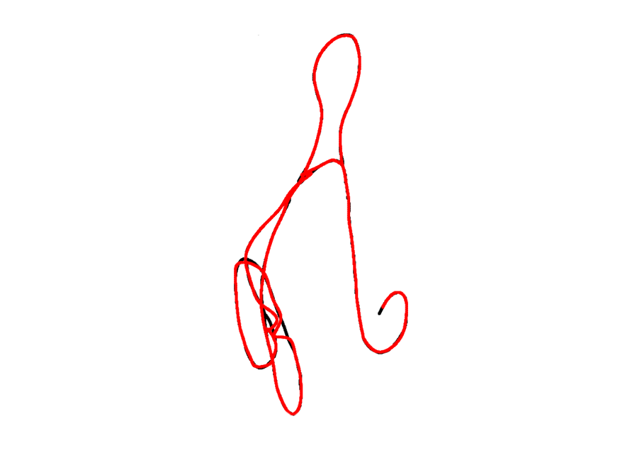
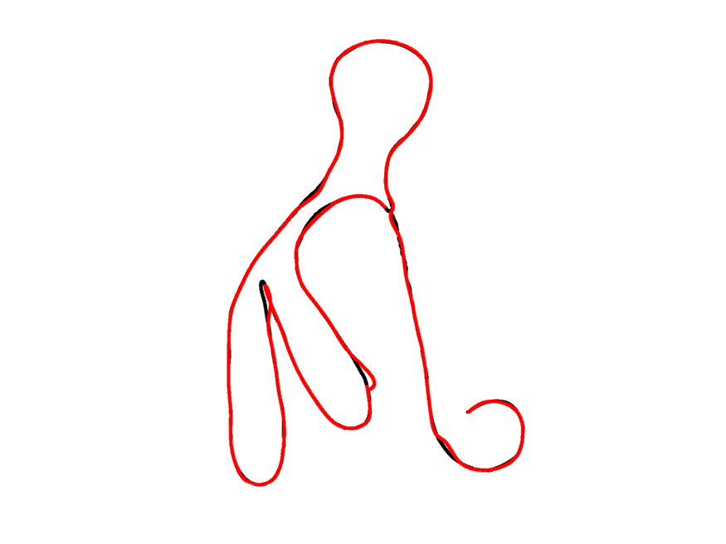
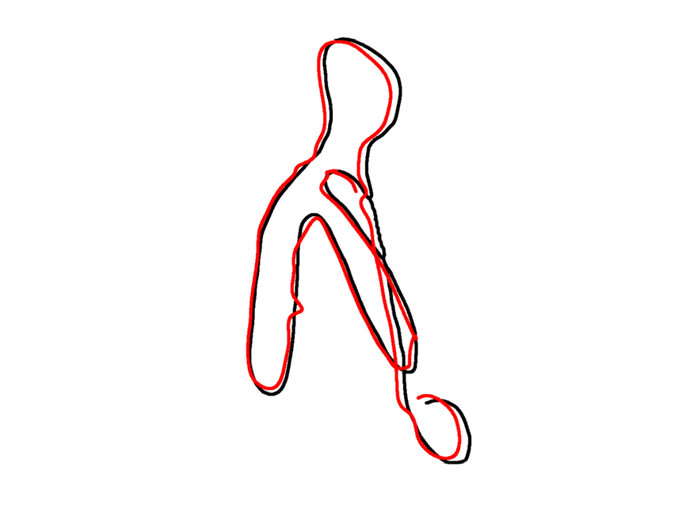

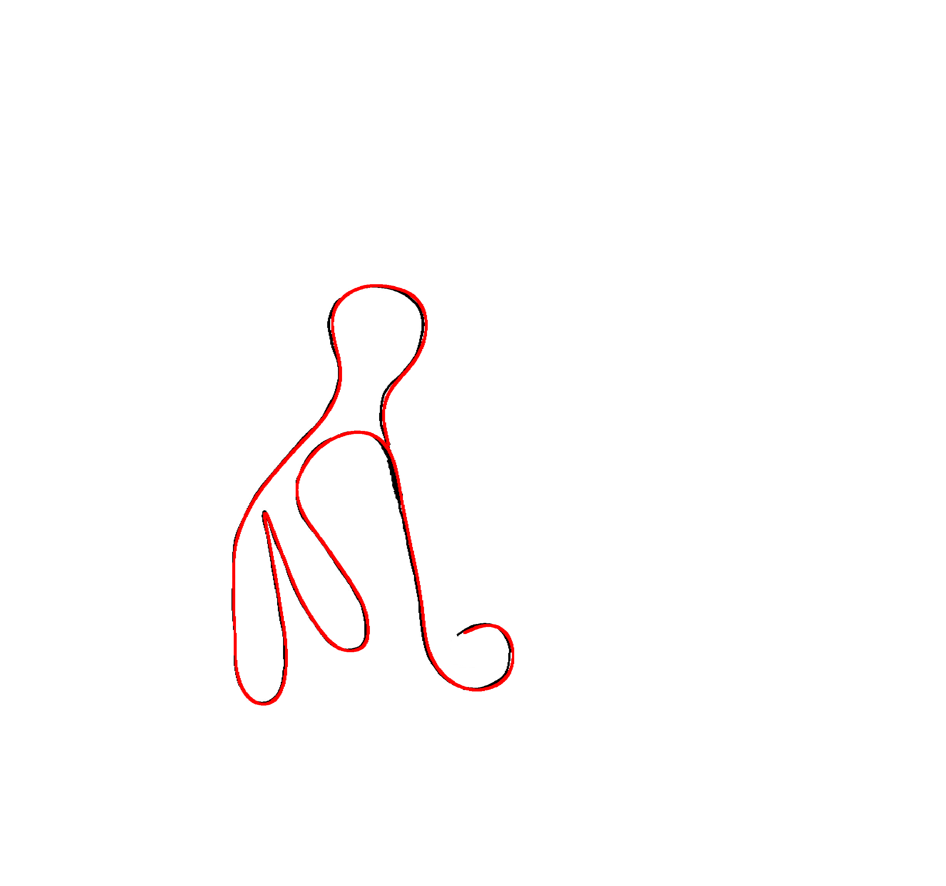
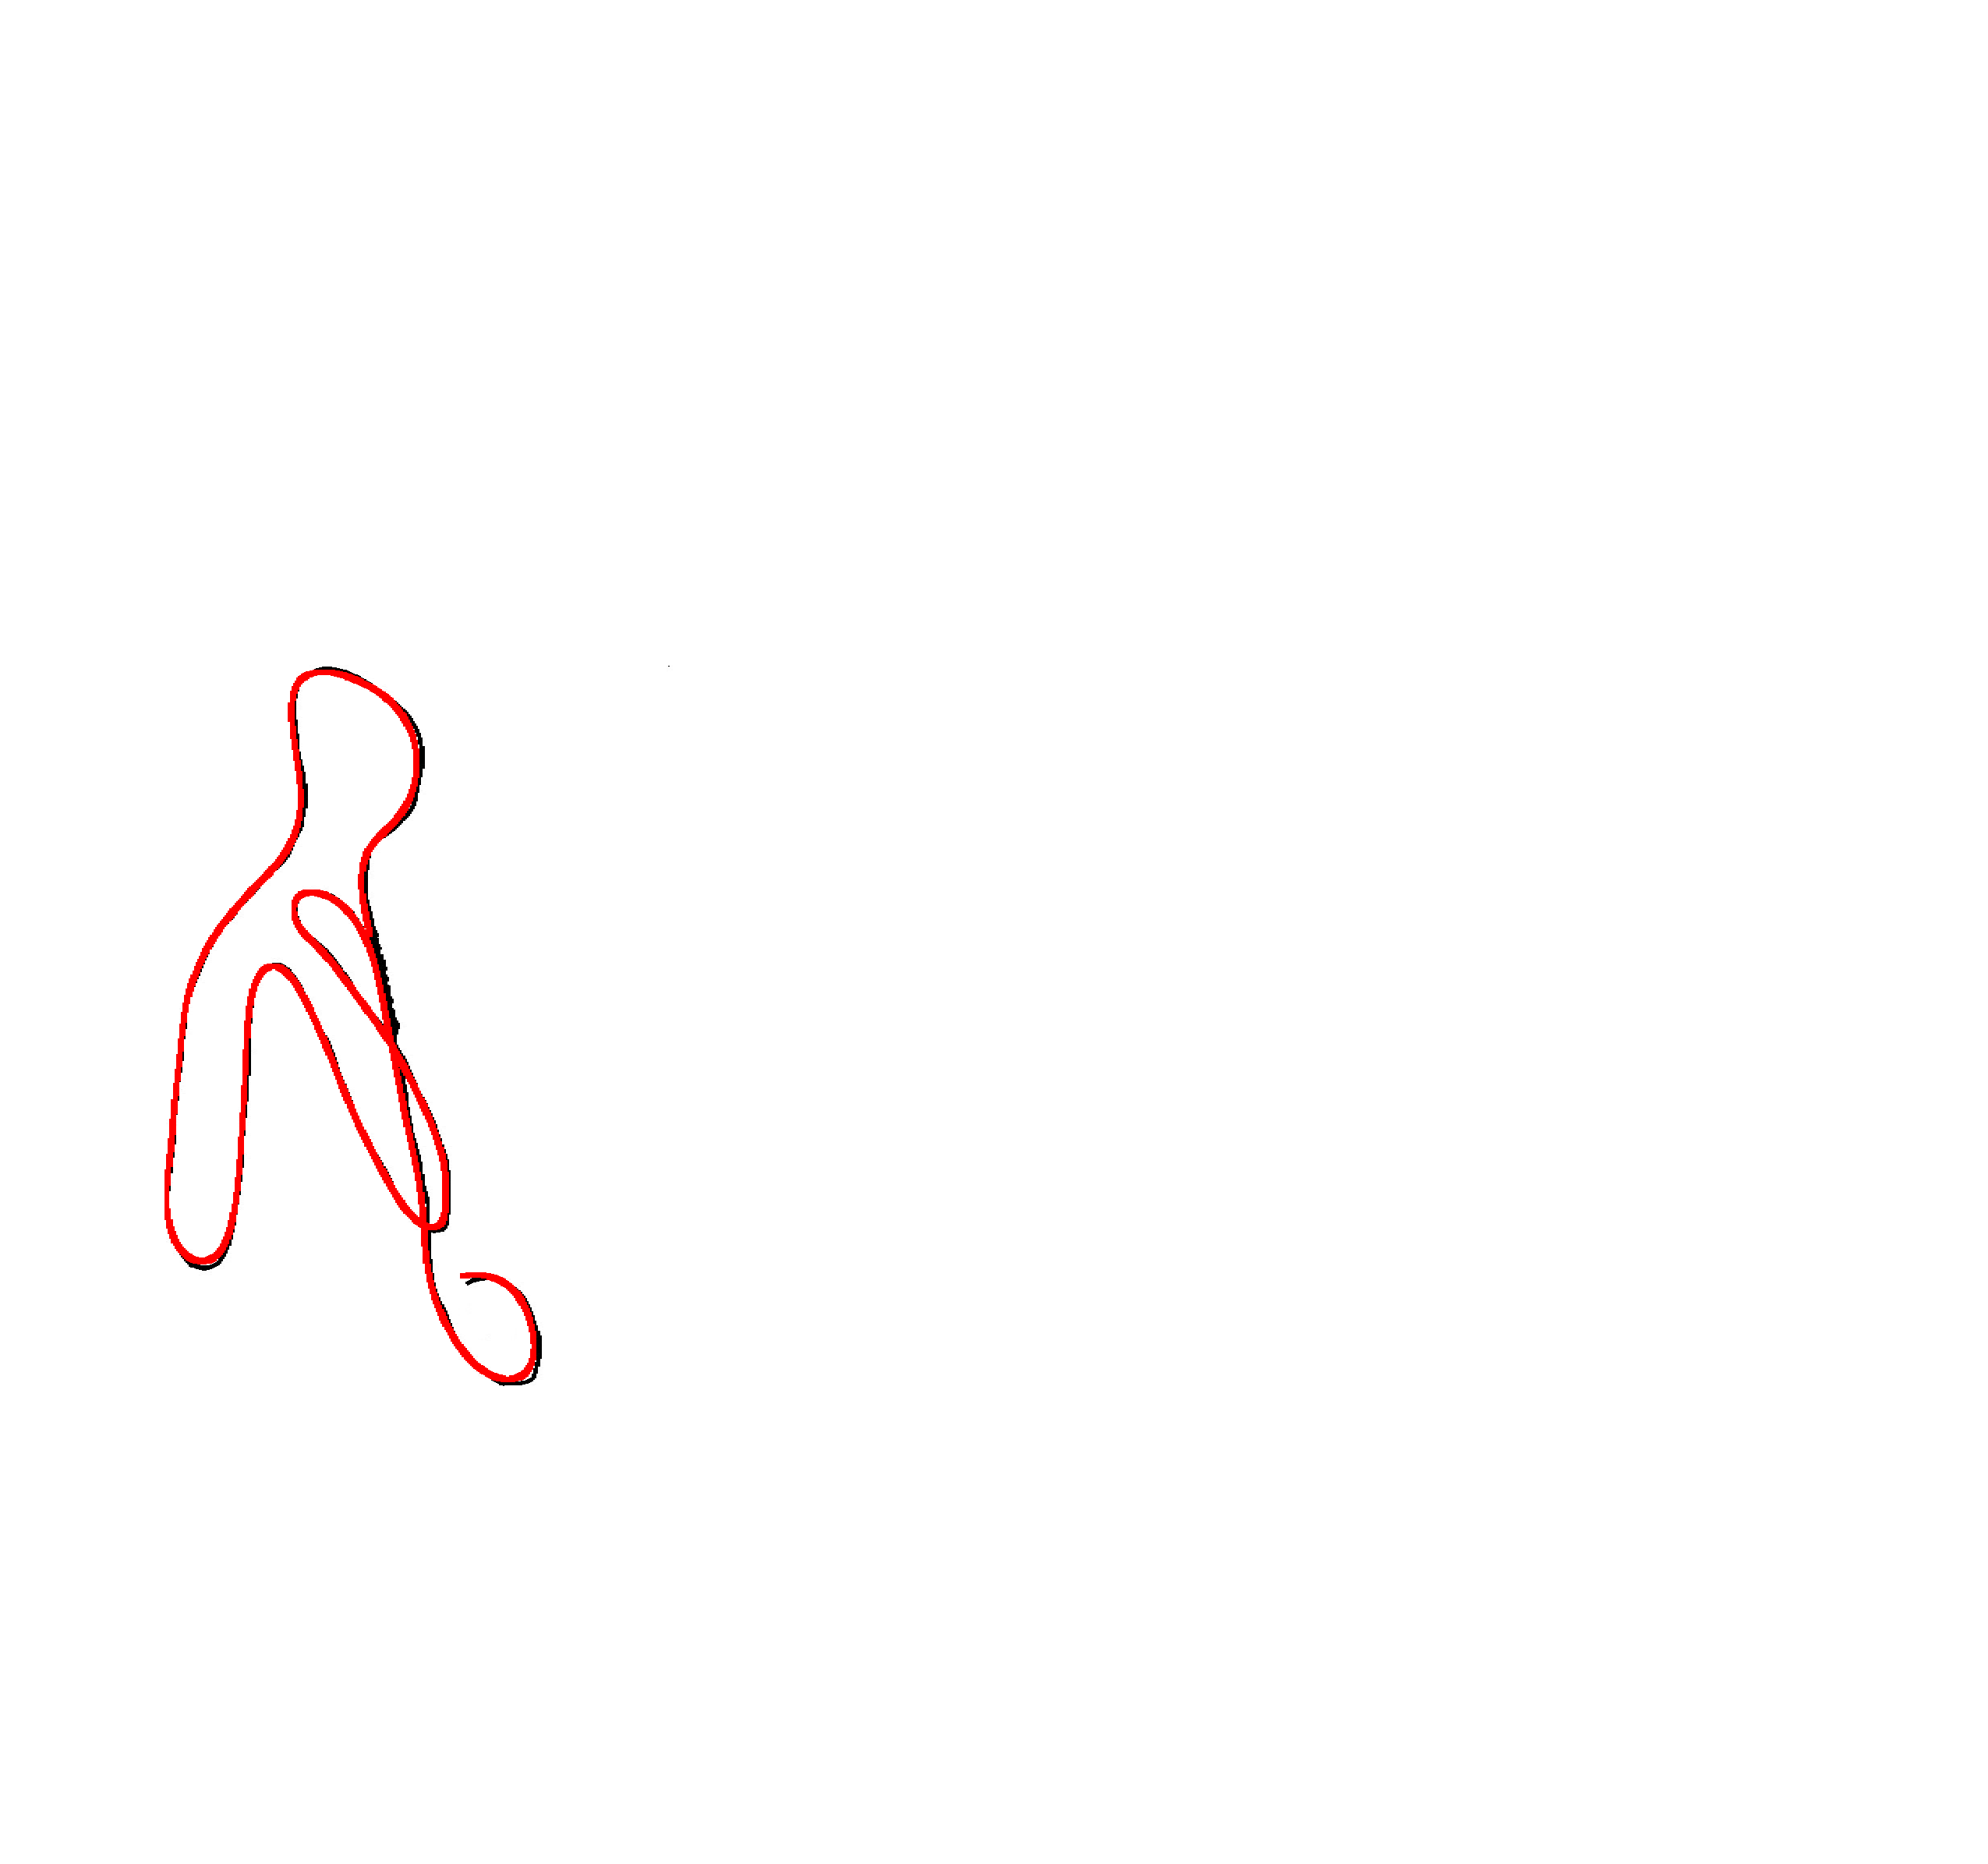
Image-guided Curve Smoothing
The difference between the projection to 2D curves in the input views
Reconstruction result
Before smoothing
After smoothing

Slide 14
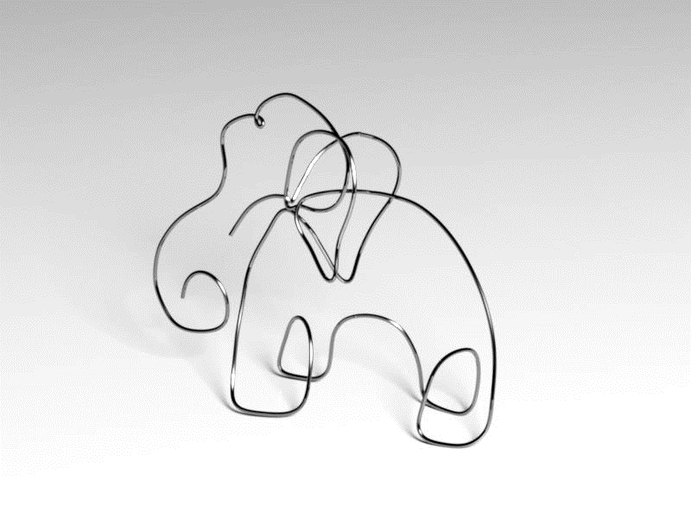
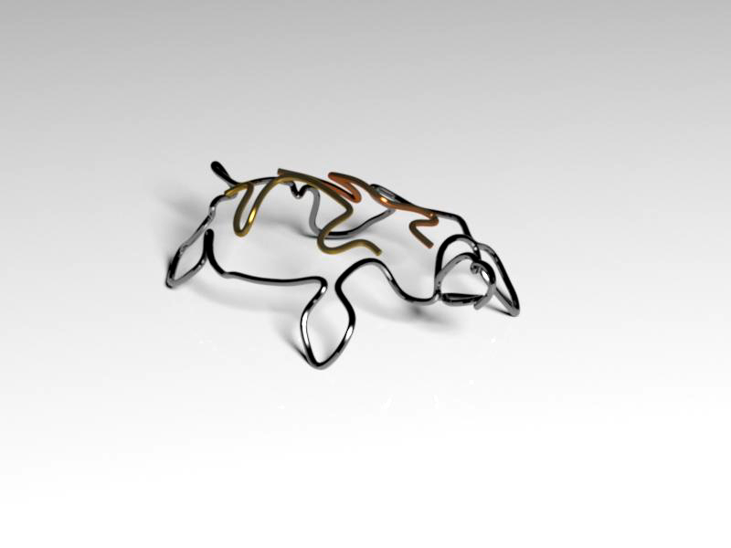
Result
Single wire model: Elephant
(Running time: 109 seconds)
Multi-wire model: Turtle
(Running time: 266 seconds)

Slide 15
Thanks for watching

